Slide 1
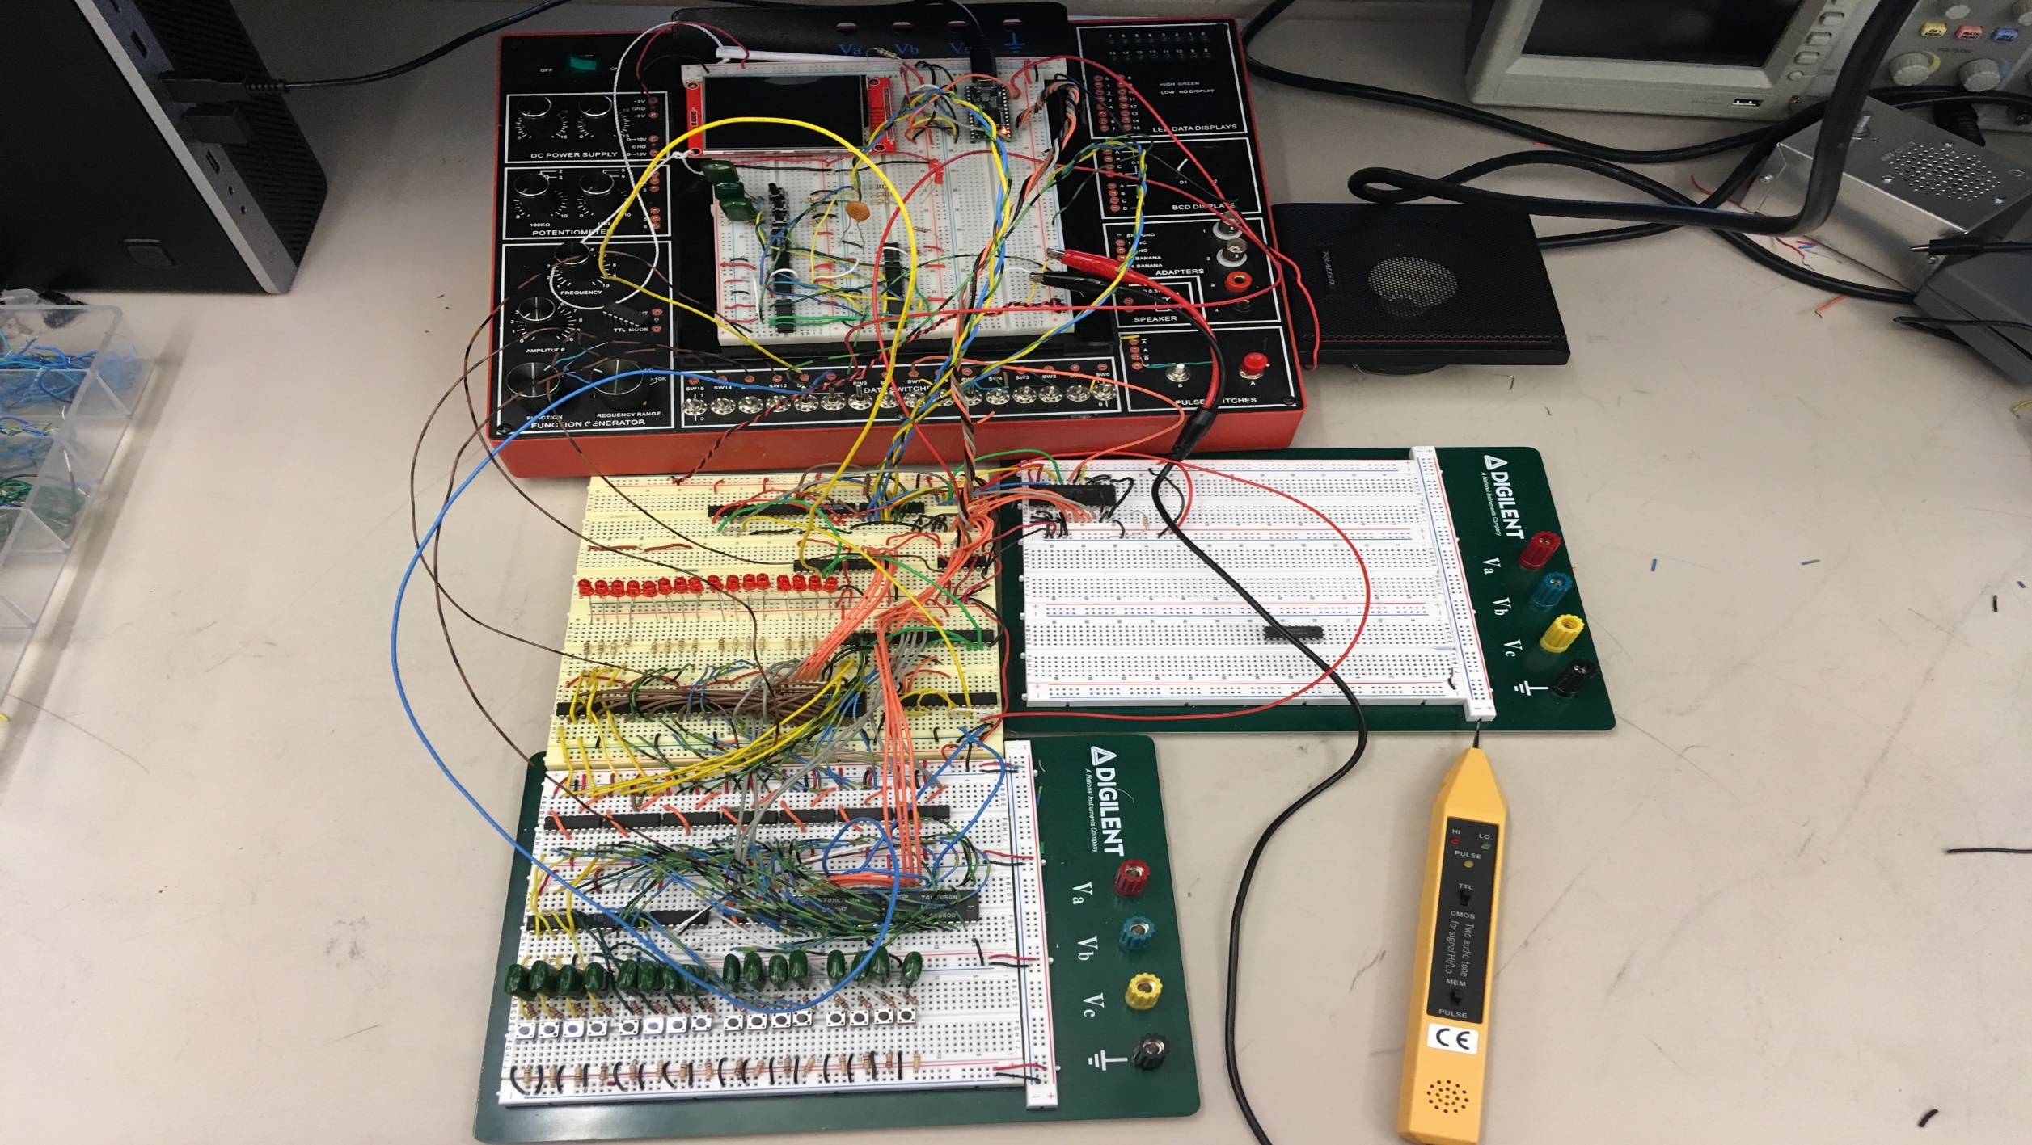
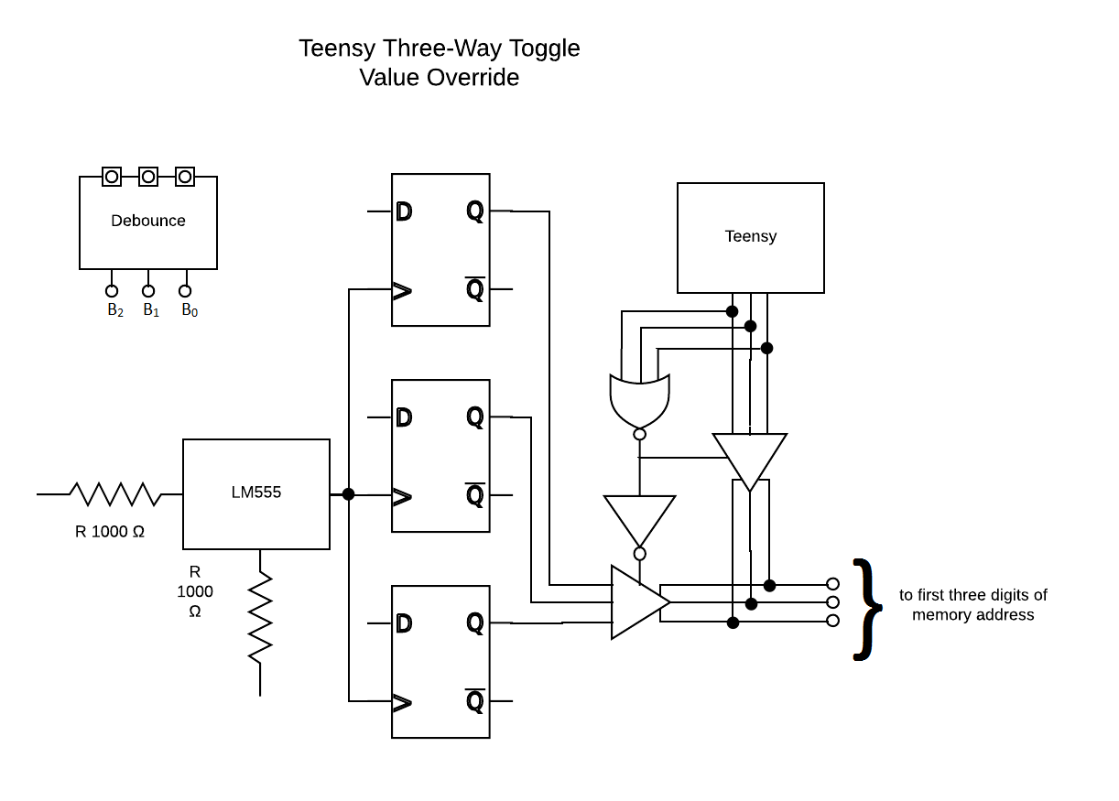
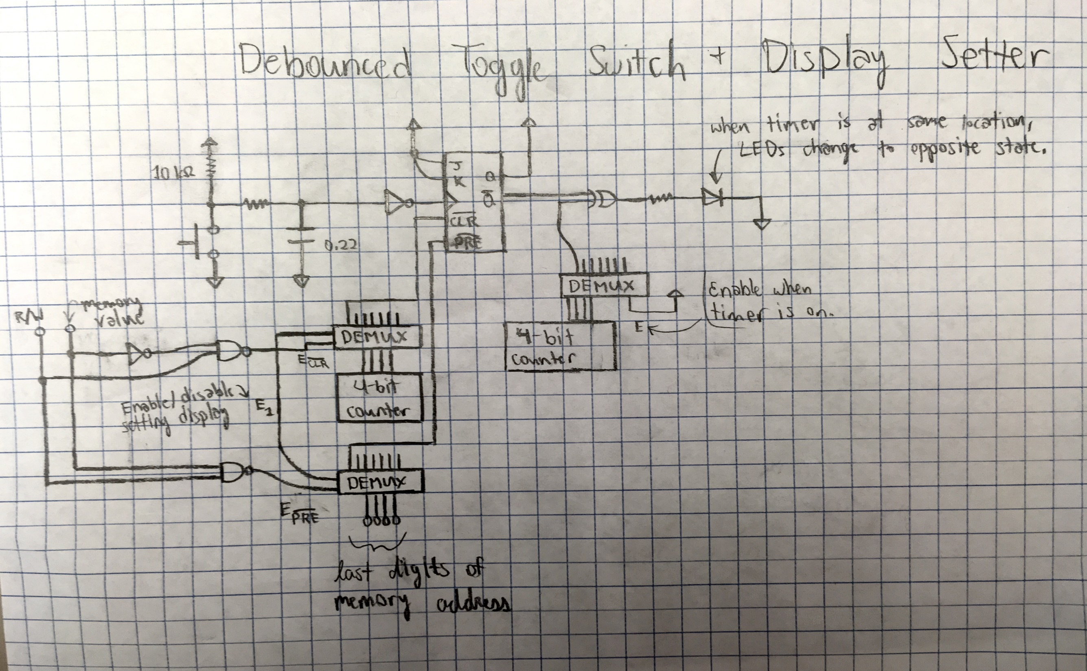
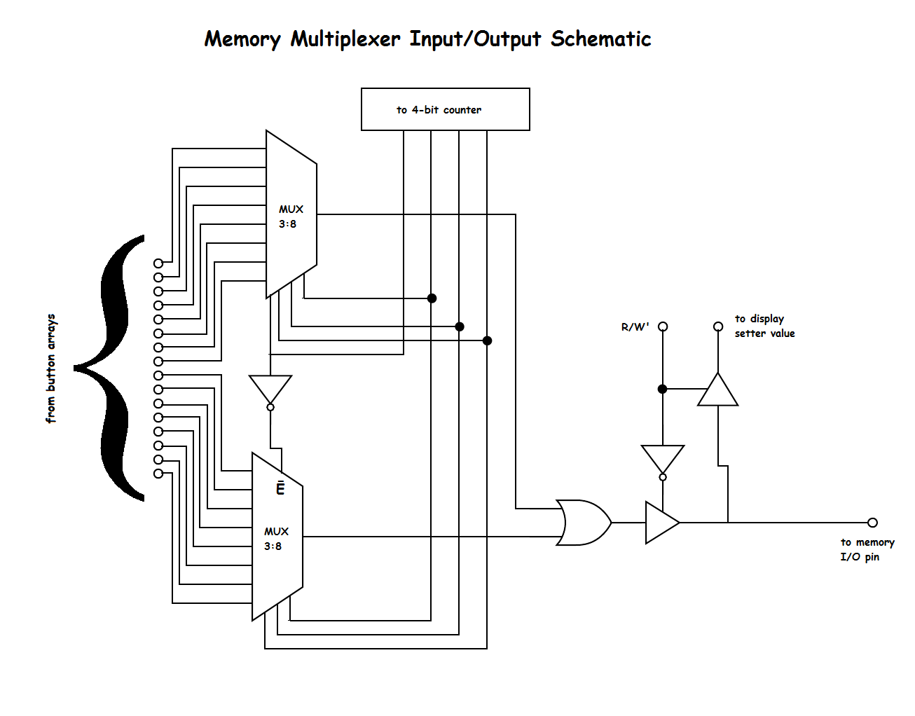
Sample Sequencer
by Brian Ma and Phillip Tran
OVERVIEW
The objective of our circuit is to act as an audio sequencer which will allow us to arbitrarily place sound samples along a timeline and play the resulting sequence. The sequencer features a row of sixteen LED lights which represent sixteen beats in a 4/4 time signature. Push-buttons wired to each LED provide a couple functions related to the sequencer: they toggle the LED, select the beat at which the chosen sample will play, and assign a sample to SRAM memory for that specific beat sequence.
In order to play the sequence for a sample – we select the audio sample in question with a three-way toggle – the circuit cycles through the memory of each beat at a tempo determined by the program loop; if that beat has been assigned a sample, the sample plays.
CIRCUIT OPERATION AND LOGIC SCHEMATICS
Our circuit uses the Teensy microcontroller system to operate two clocks, Clock A and Clock B, which feed into 4-bit counters running our sequencer.
During normal operation, SRAM is set to “write” mode. We use the three-way toggle to select a sample (different instruments) and the push-buttons to place the samples along the LED sequence.
With each tick of Clock A, Teensy cycles through the LED sequence and reads the corresponding memory for each beat, where a sample will be played if assigned to that beat’s memory. This occurs at a low tick frequency which will give us our tempo; e.g. a tick speed of 1.5 Hz corresponds to 90 BPM.
Clock B establishes a relatively high tick frequency of about 1000 Hz which allows SRAM to be updated constantly.
When the three-way toggle is used, the display changes change to the pattern stored for the corresponding instrument. Thus, the SRAM is set to “read” mode and the display setter module is enabled. Teensy then ticks Clock B sixteen times, effectively updating the value of all the LEDs before returning to normal operation.
Above and to the left of this text are labelled and annotated schematic diagrams of three interconnected parts of the circuit. These parts would have been mildly inconvenient to display if combined in a large schematic diagram.

